Slide 1


StatsWrap
Make your workout work for you
Alex Laughlin & Tino Pimentel

Slide 2
Our Vision
For a fitness enthusiast that likes to know every intimate detail of their workout, StatsWrap is an activity tracker that records and graphs all of one’s fitness data in real time. This allows athletes to customize their workouts with incredible accuracy. Unlike competitors, StatsWrap focuses on keeping your data secure and presenting high fidelity information in a concise live graph.

Slide 3

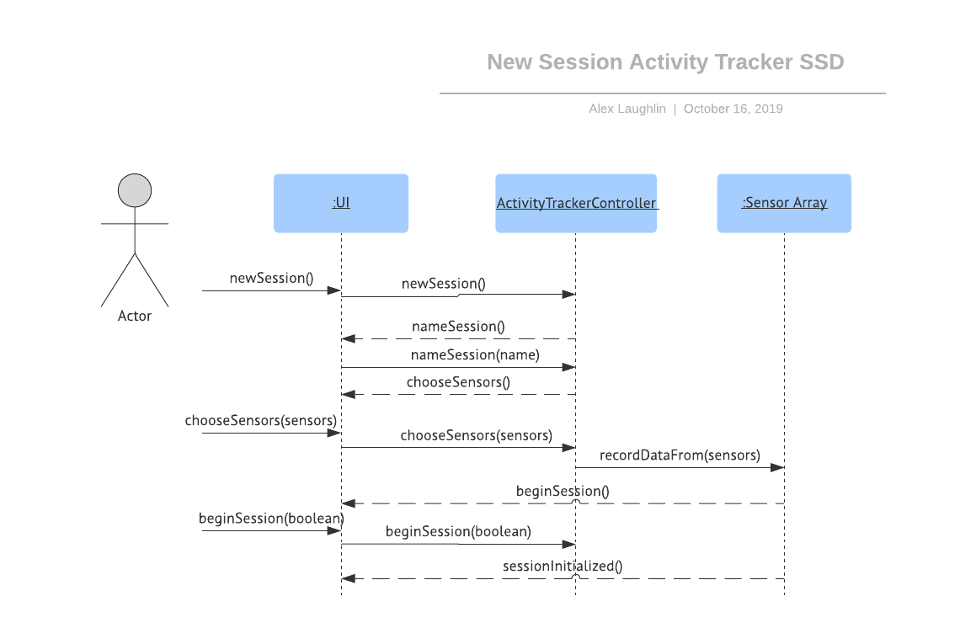
New Session? No Problem!

Slide 4
With StatsWrap, creating a new session is just a click away at any moment. Log any kind of activity you’d like to customize your workout to your needs.

Slide 5

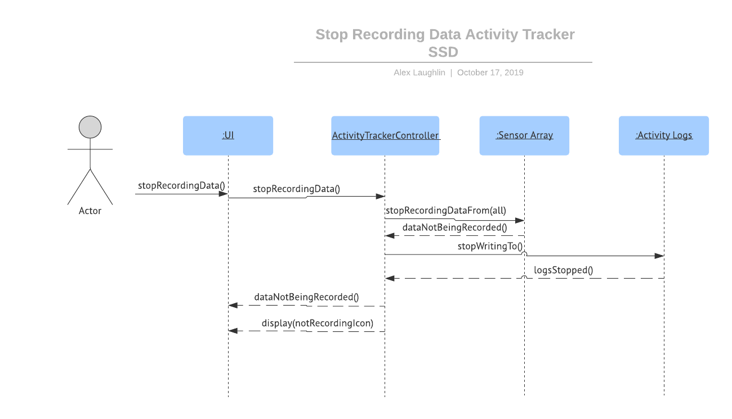
Maintain your privacy easily with StatsWrap

Slide 6
Keep YOUR data in YOUR hands! StatsWrap users can stop recording data at the press of a button to maintain their privacy.

Slide 7

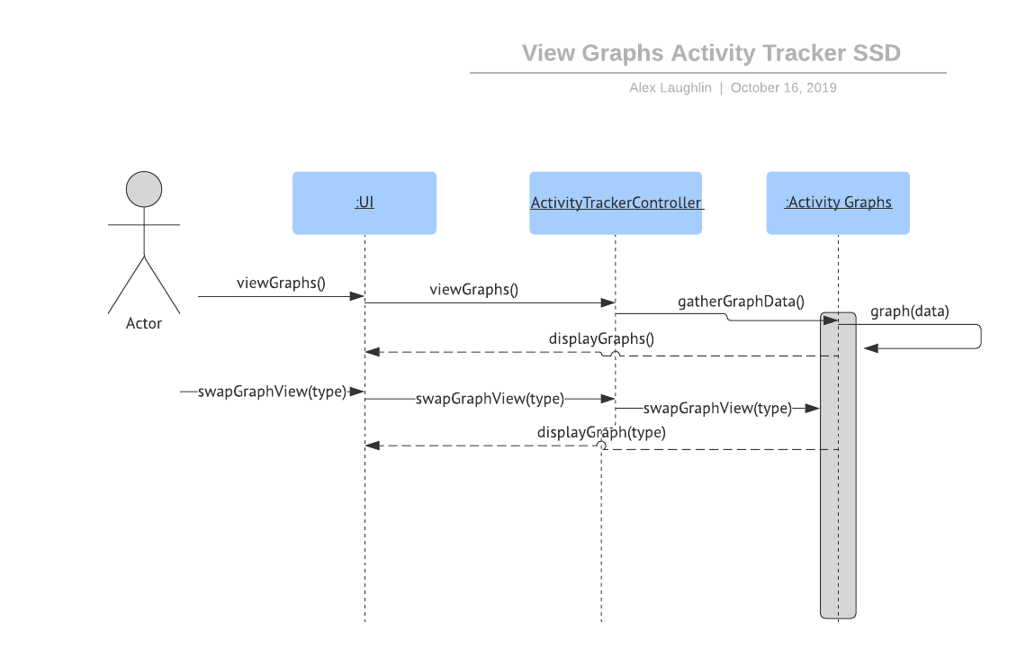
View your activity graphs at a glance to nail your workout goals

Slide 8
StatsWrap is designed with workouts in mind. Are you hitting your mile pace? Have you taken enough steps today? Find out in seconds with StatsWrap’s live activity graphs.

Slide 9

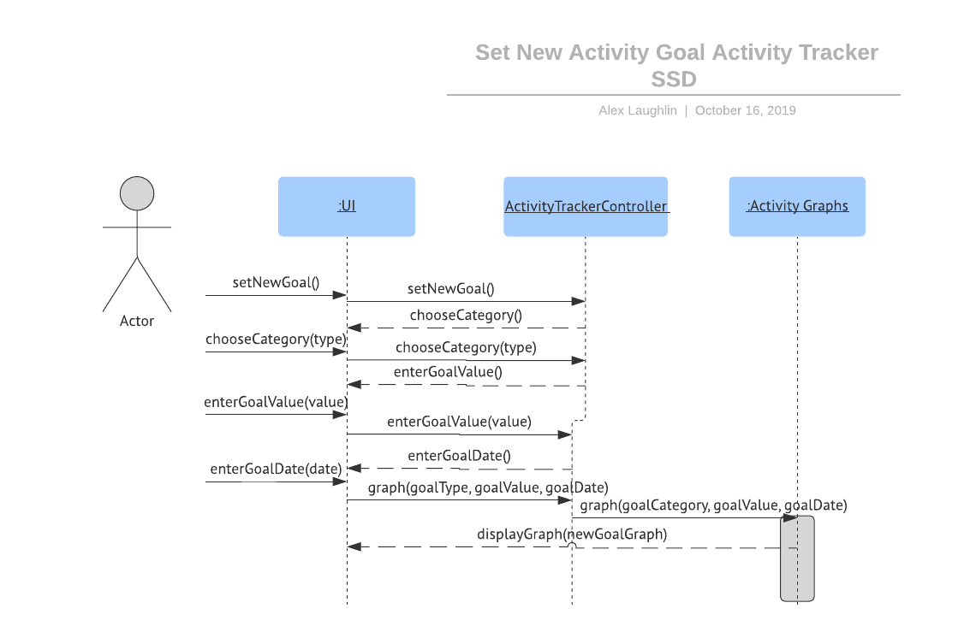
Stride towards excellence with StatsWrap’s goal setting feature

Slide 10
If your goals are becoming too easy, dream bigger with StatsWrap! Set a new activity goal in any category with StatsWrap’s new goal setting feature.

Slide 11

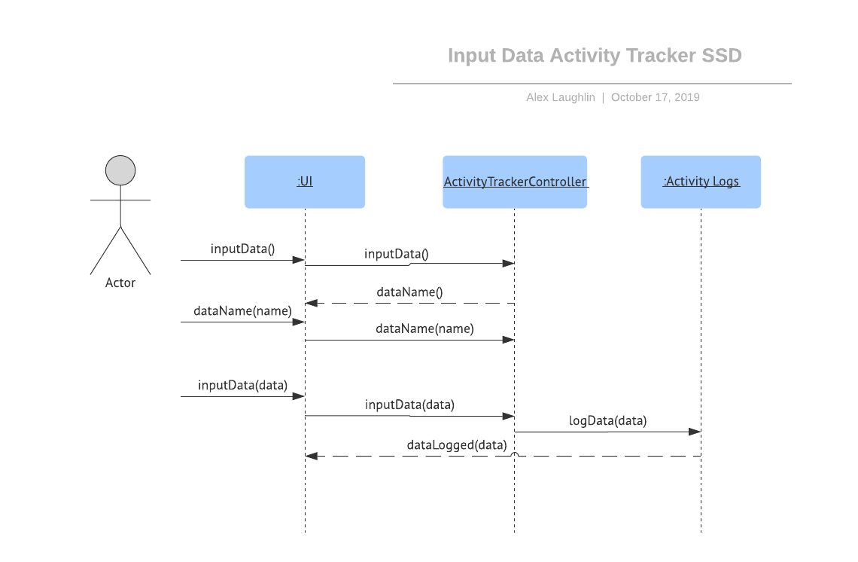
Track customized statistics easily with StatsWrap!

Slide 12
With the power of StatsWrap at your fingertips, you can track anything you’d like! Enter your weight, calories consumed, mood, or anything else that affects your workout to maximize your performance.

Slide 13

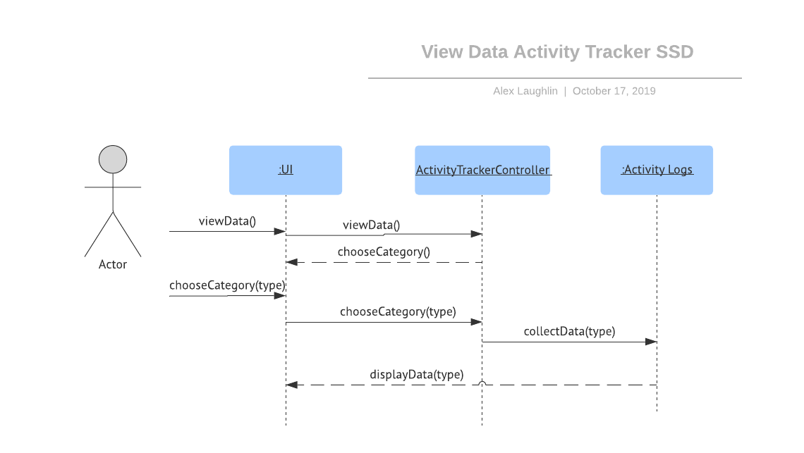
Graphs not doing it for you? View your raw data easily with StatsWrap

Slide 14
Graphs are great during your workout for understanding how you’re doing. Sometimes, though, a serious athlete wants to know exactly how they performed. With StatsWrap, your activity data is just a click away.

Slide 15

StatsWrap
Make your workout work for you

Slide 16
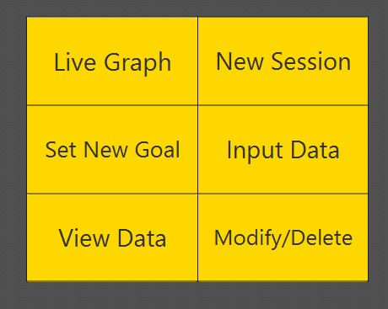
Main Menu

Slide 17
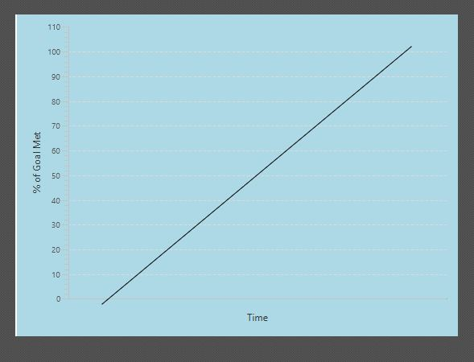
Live Graph

Slide 18
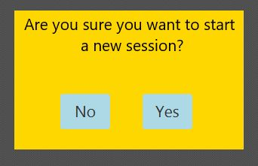
New Session

Slide 19
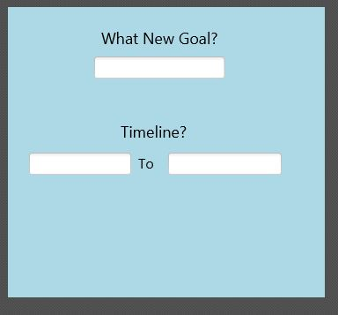
Set New Goal

Slide 20
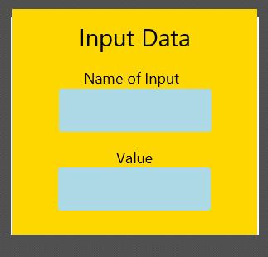
Input Data

Slide 21
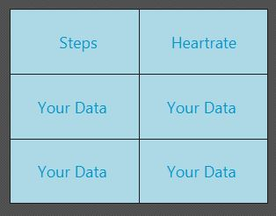
View Data

Slide 22
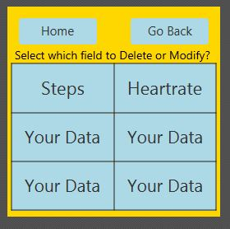
Delete/Modify

Slide 23
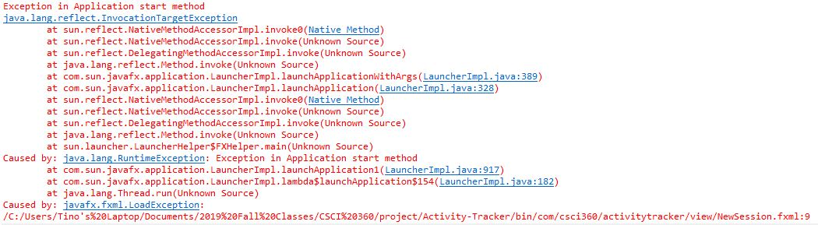
Problems
When executing JavaFX code with FXML files included, Exception error continues.

Slide 24
Looking Forward
Complete transitions from buttons
Add Home and Back buttons for every screen.
Take input from text boxes on GUI
Finish implementing the rest of our classes / controllers. (ETA by November 14th).

